Slide 1
Python in 2 hours
Andy Woods, Royal Holloway
21 October, 2026

Slide 2
About me
Psychologist: multisensory perception
Unilever R&D: taste experiments, built the hardware
Been in several startups
Love web development: Python and Django
  Paper: Django for behavioural researchers (Behavior Research Methods, in revision)
CanIStillCode.org: does AI help or hurt our coding?
PhD students:
  AI and coding
  some in psychology (Hannah, Paulina)

Slide 3
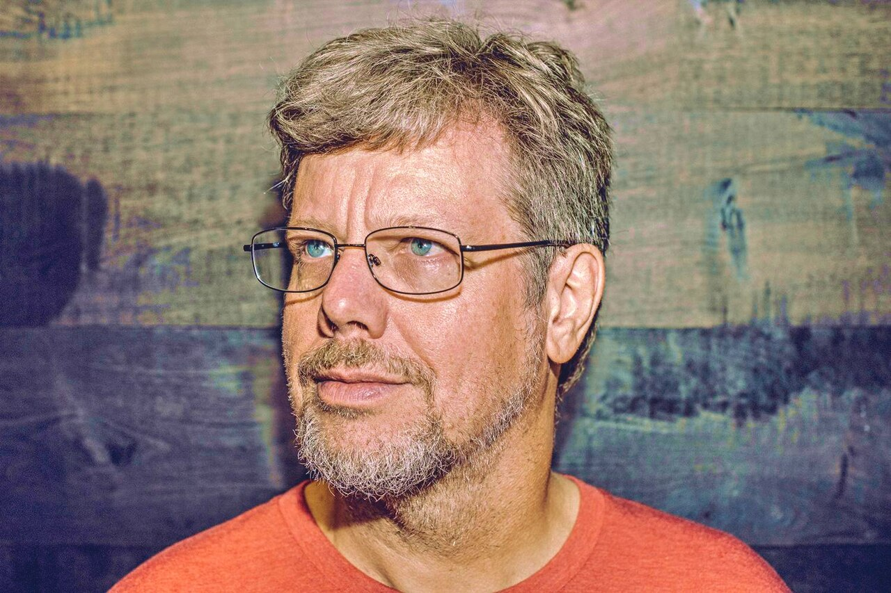
Where it came from
Guido van Rossum, Amsterdam, Christmas 1989
A hobby project over the holidays
First release 1991
Photo: Daniel Stroud, CC BY-SA 4.0

Slide 4
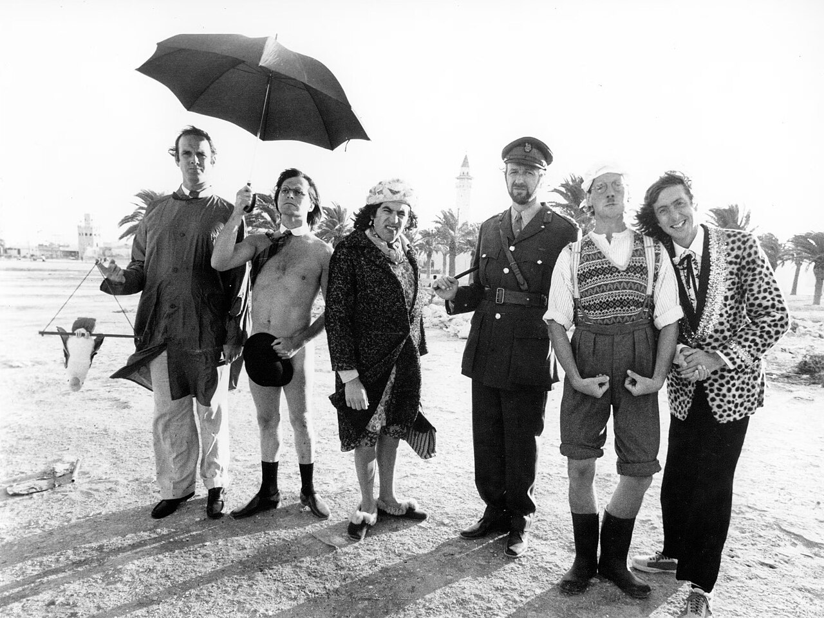
Why "Python"?
Named after Monty Python's Flying Circus
Not the snake
Examples in the docs use spam and eggs
Monty Python, 1978. Public domain

Slide 5
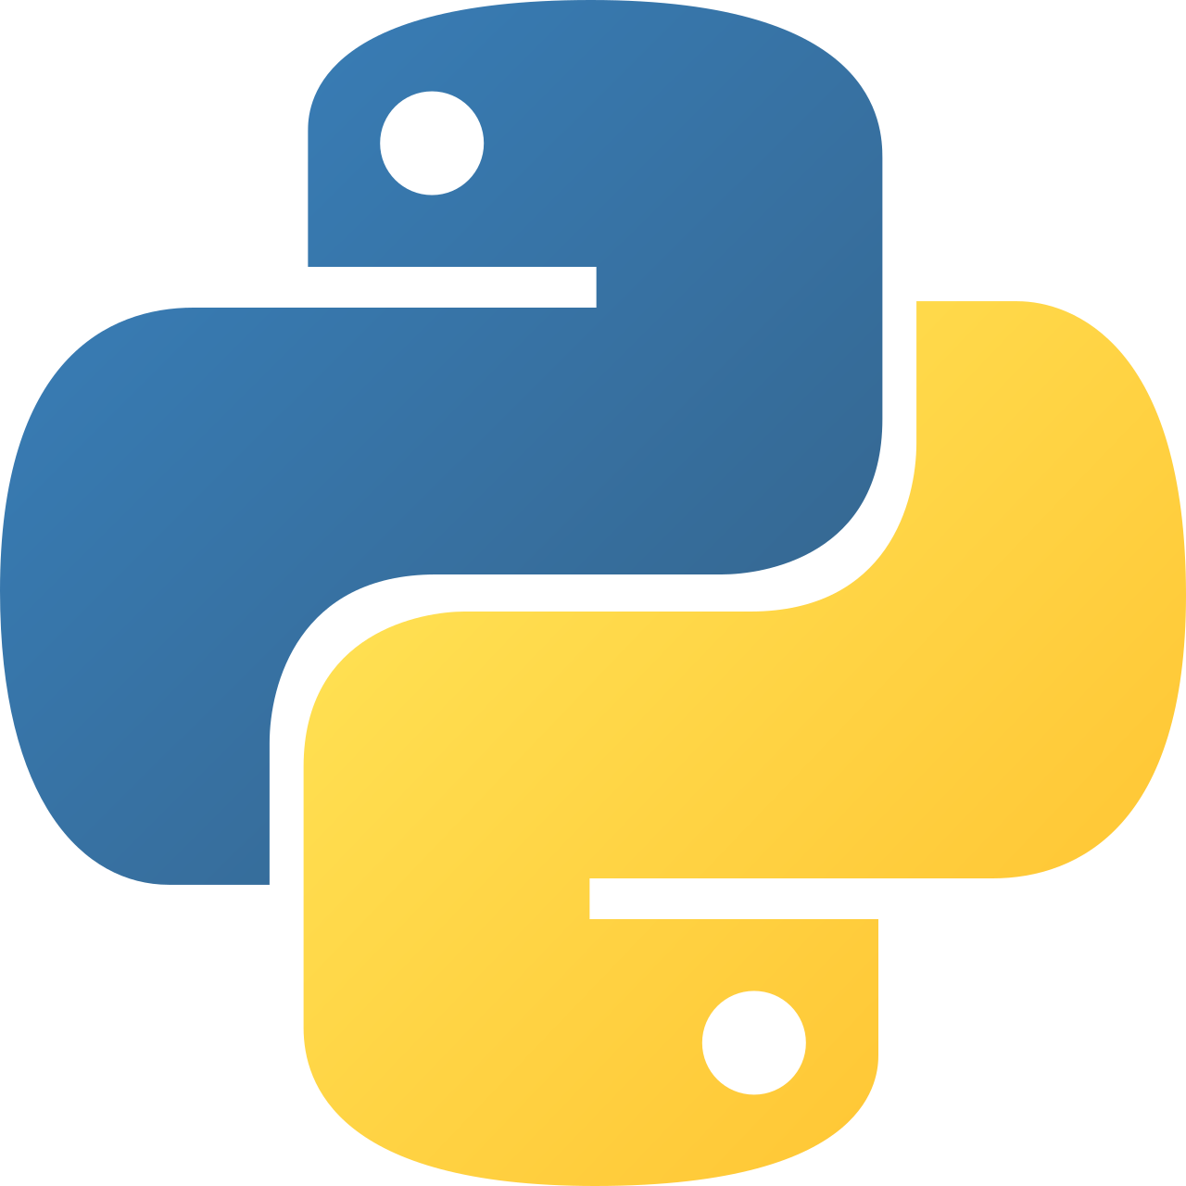
Why its popular
Reads almost like English
Free, runs everywhere
Huge library for science, data and AI
Among the most used languages in the world

Slide 6
Try this
import this
The Zen of Python: "Readability counts"

Slide 7
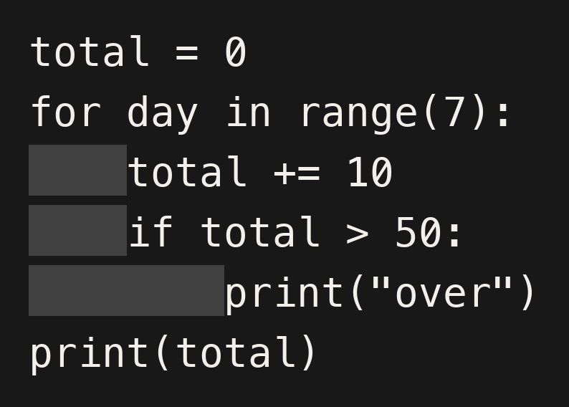
Quirk 1: indentation
No { } to group lines
The indent decides what is inside a loop or if
Use 4 spaces (or tab!), every time
A line ending in : means "indent the next lines"

Slide 8
Quirk 2: counting starts at 0
First item is x[0], not x[1]
range(5) gives 0, 1, 2, 3, 4
The end number is never included

Slide 9
Quirk 3: small differences from R
= not <-
True / False, not TRUE / FALSE
** for powers. ^ means something else
import not library()

Slide 10
Quirk 4: lists are not vectors
In R, c(1, 2) * 2 gives 2 4
In Python, [1, 2] * 2 gives [1, 2, 1, 2]
We use loops instead, or numpy later

Slide 11
Quirk 5: dots do things
history.append(5) adds to a list
The thing comes first, then what to do to it

Slide 12
Errors are normal
Read the last line first
Most errors today: a typo, a missing :, or a wrong indent

Slide 13
Today
Google Colab: nothing to install
Shift+Enter runs a cell
Run cells in order, top to bottom

